Slide 1
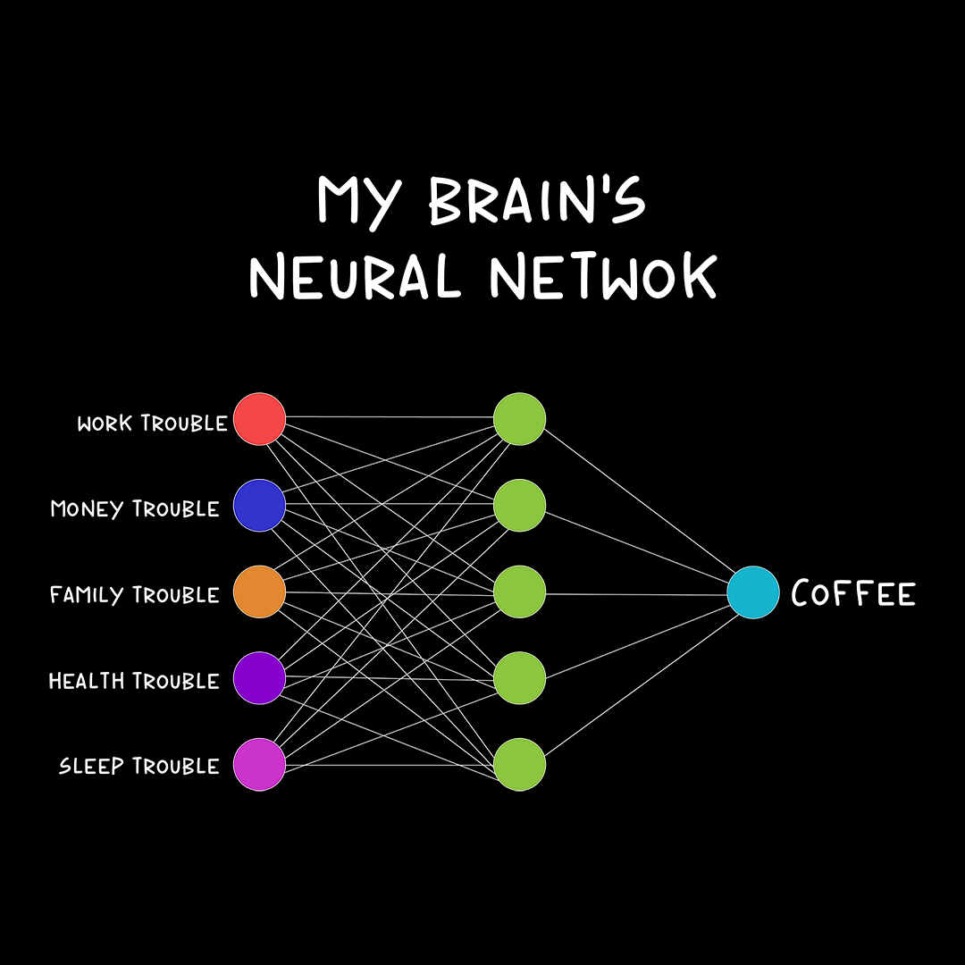
Short break.
Back at ….

Slide 2
Review
Input Data
Linear regression
Gradient
Parameter
Hyperparameter
Epoch
Batch size
Learning rate
Regression
Classification
Loss function
Activation function
MLP
Weights
Model
Weight update
Prediction Y’
Reality Y
Optimizer
Loss

Slide 3
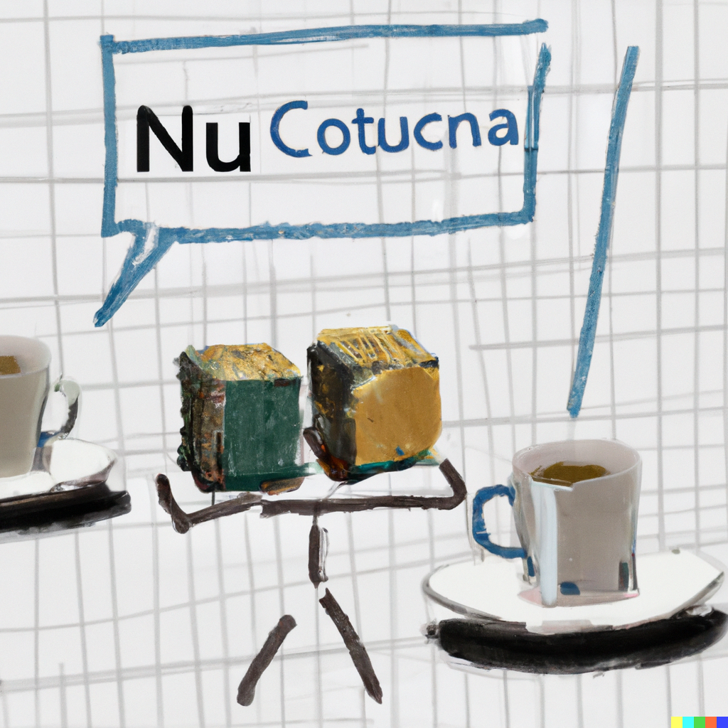
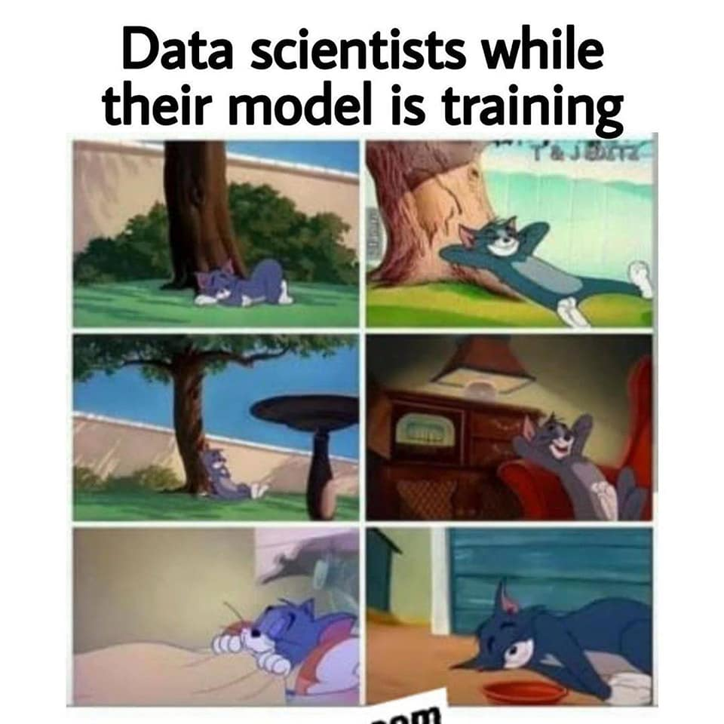
Break
A convolutional neural network taking a coffee break
Panos x DALLE2
Notes:
David

Slide 4
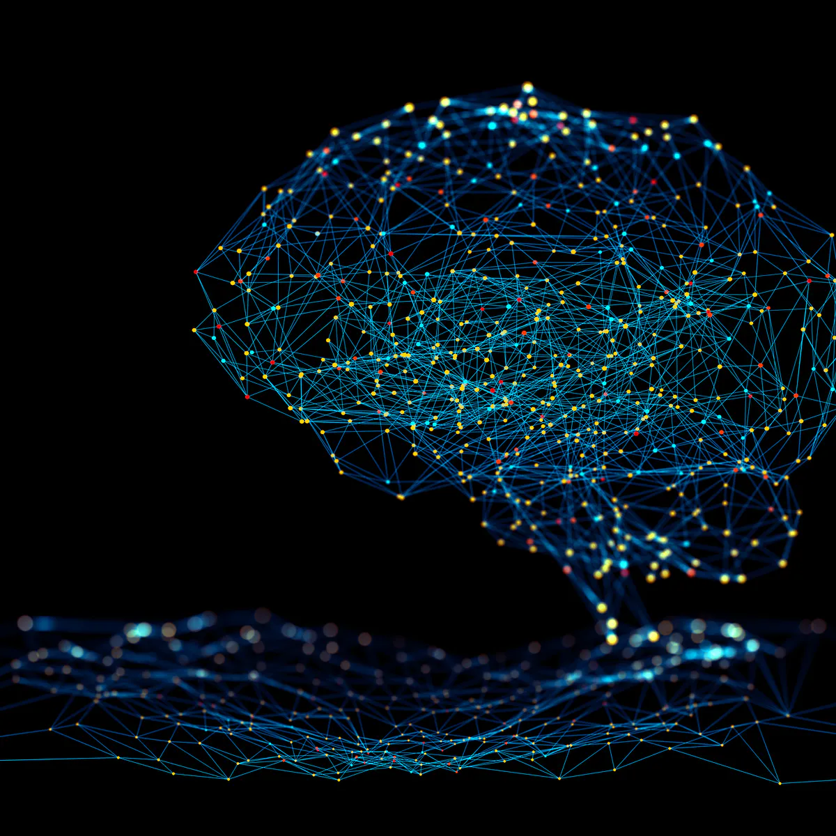
Convolutional Neural Networks

Slide 5

MLP drawbacks
Weight for each value - too many parameters!
The same pattern in different place behaves differently
Treats the input as a row of values
No proximity, no sense of local neighbourhood
Notes:
TODO - what drawbacks does Dense NN have for a sequence analysis; OR what advantages does CNN have
https://www.quora.com/What-is-shift-invariance-in-a-convolutional-neural-network-CNN

Slide 6
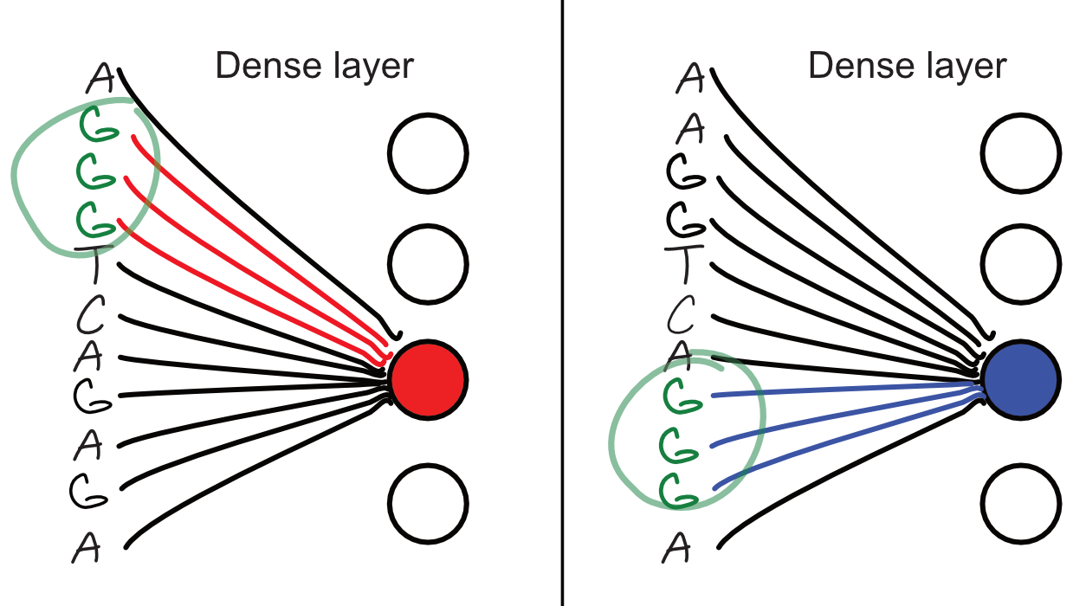

Slide 7
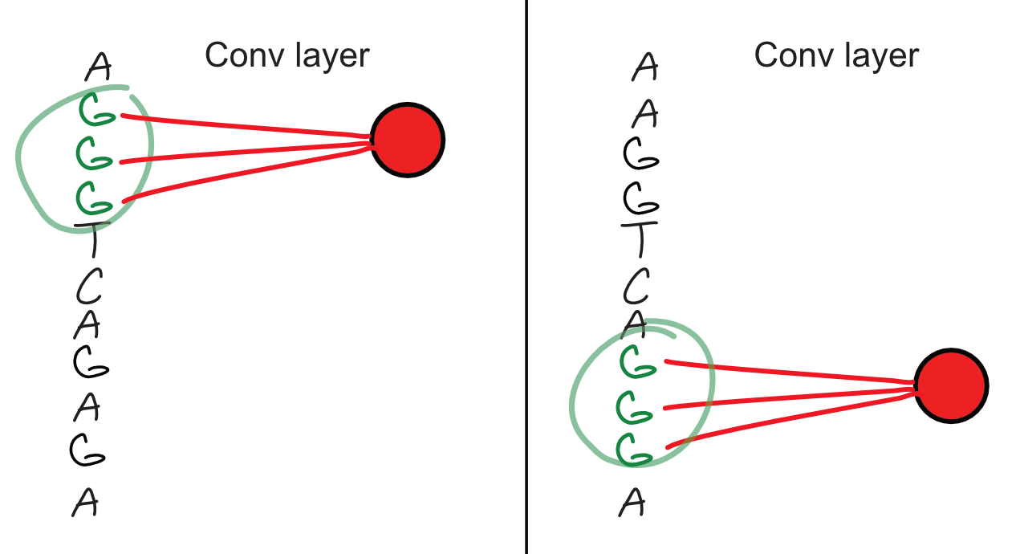

Slide 8
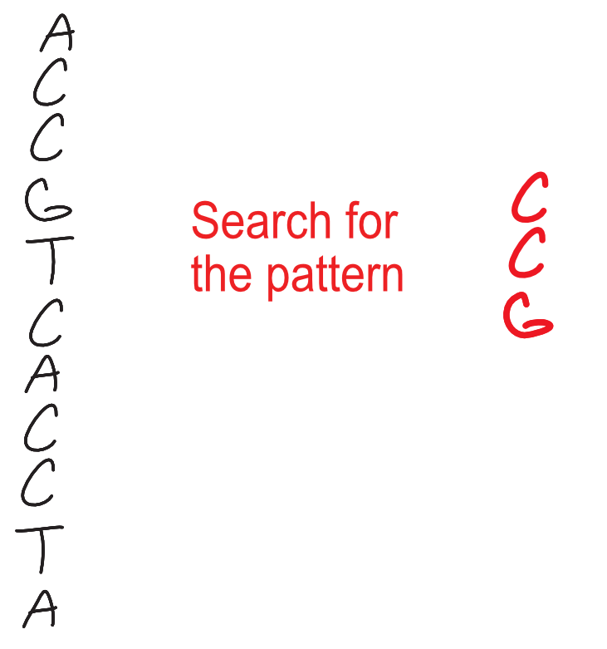

Slide 9
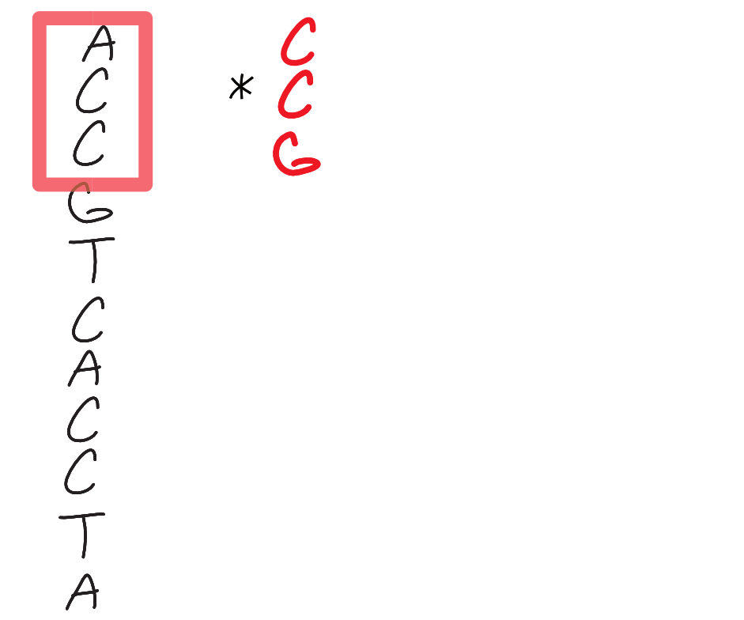

Slide 10
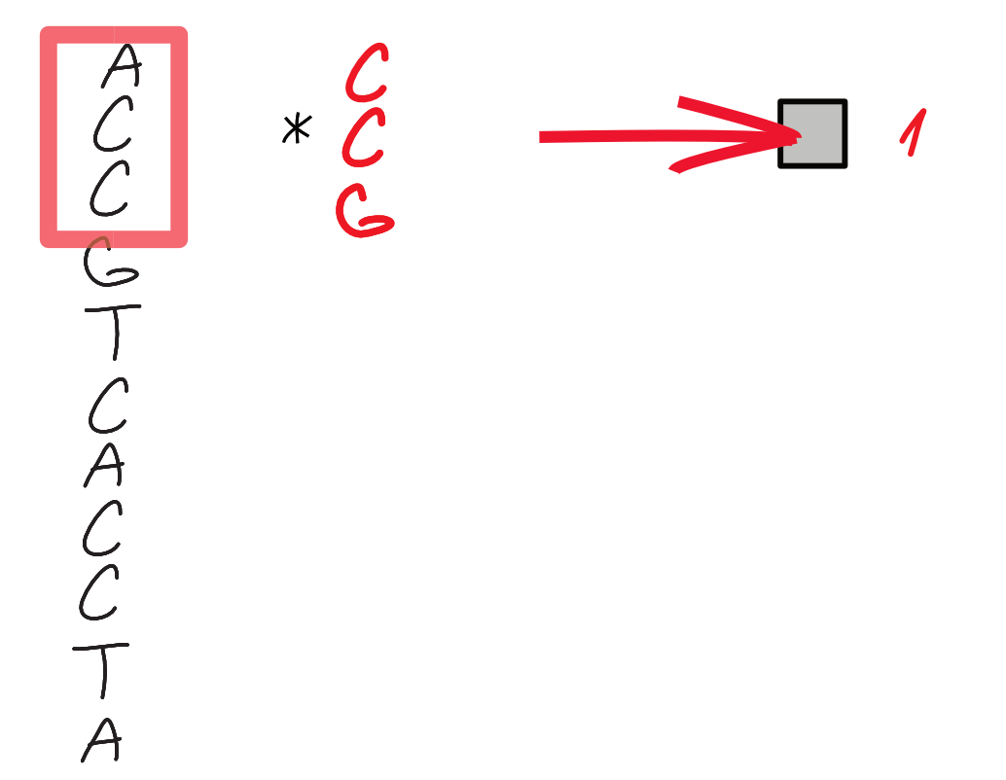

Slide 11
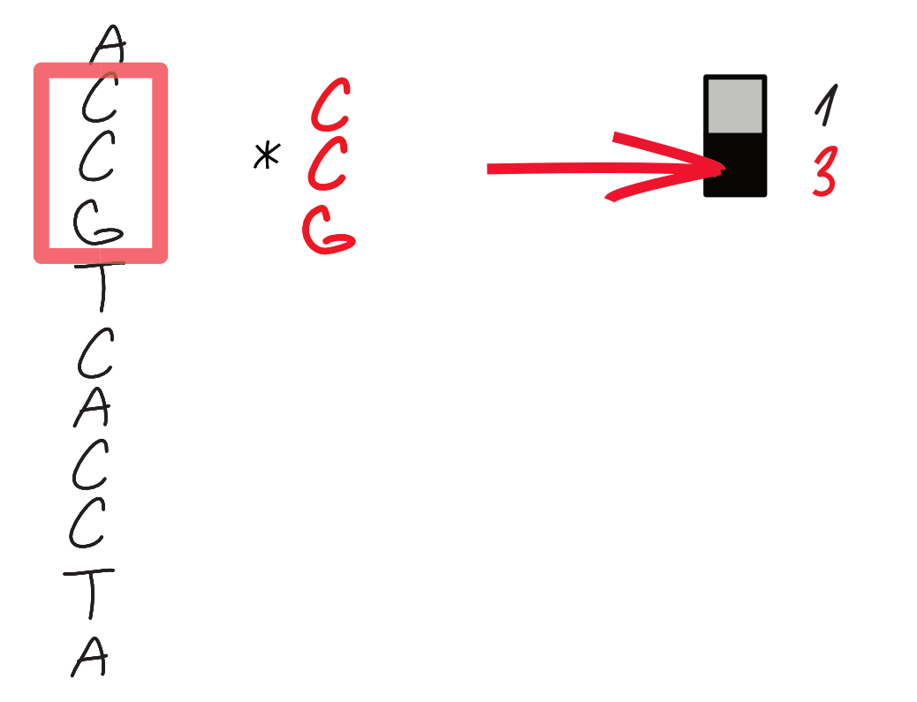

Slide 12
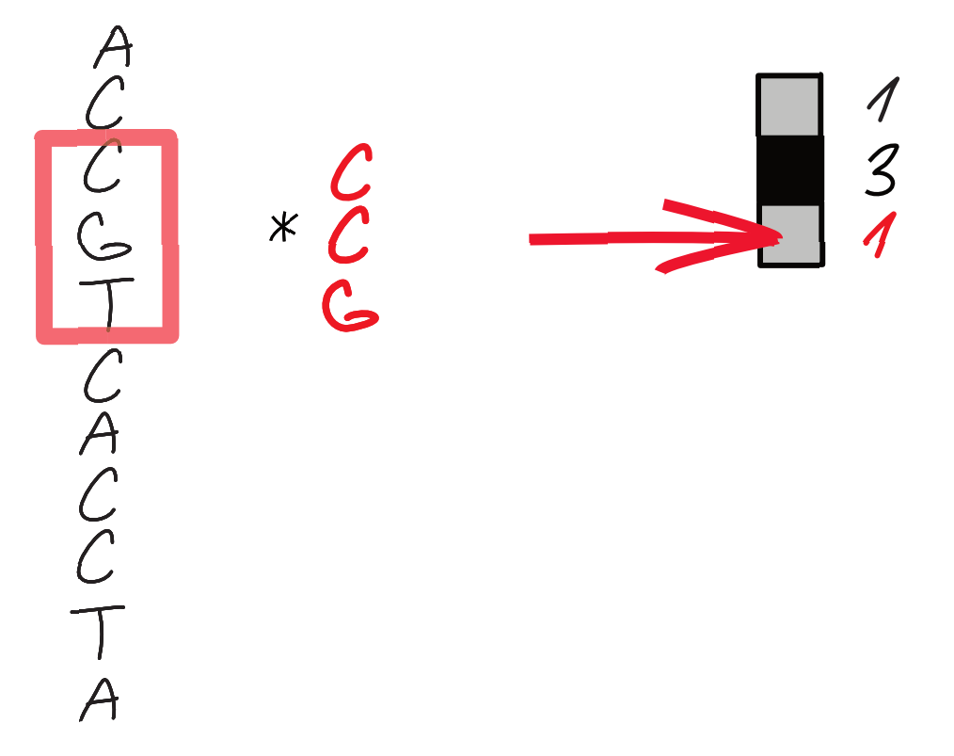

Slide 13
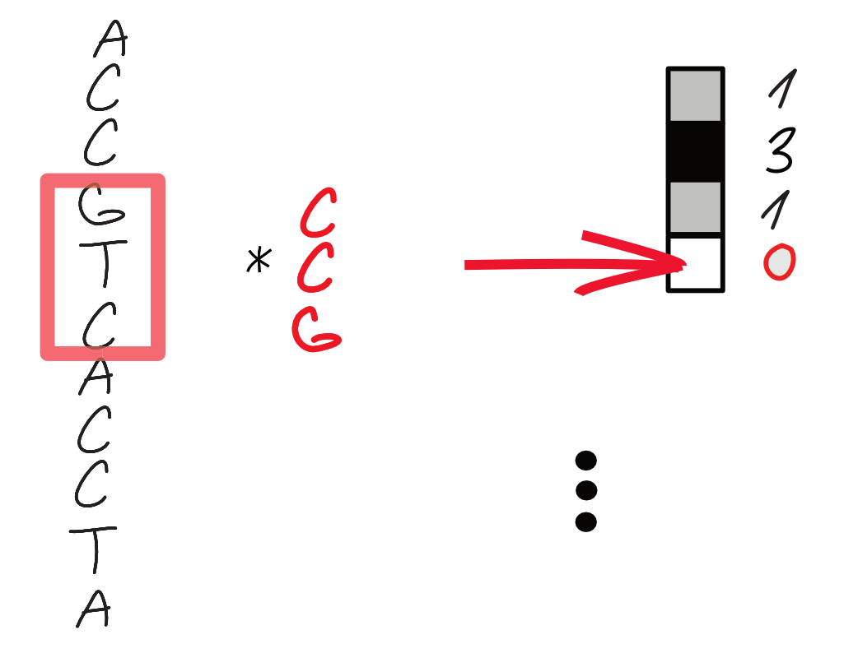

Slide 14
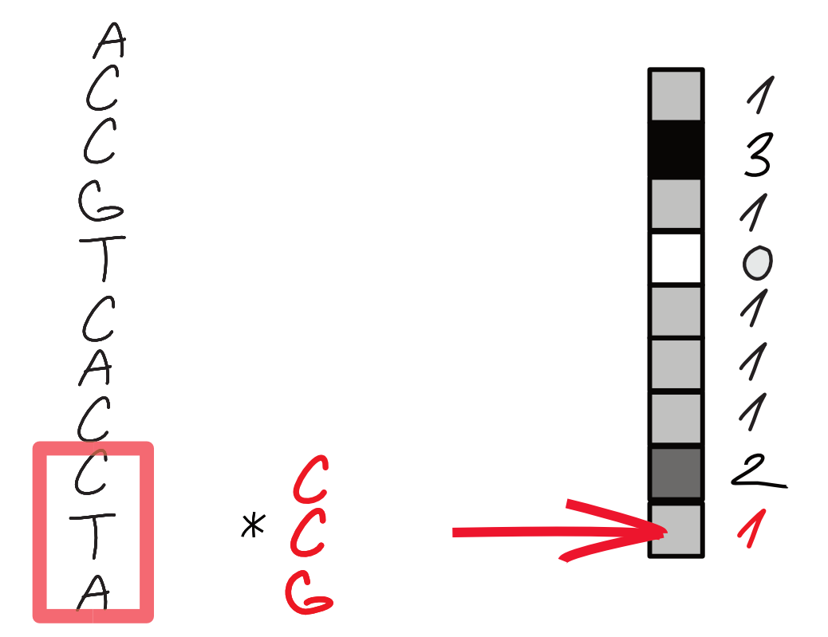

Slide 15
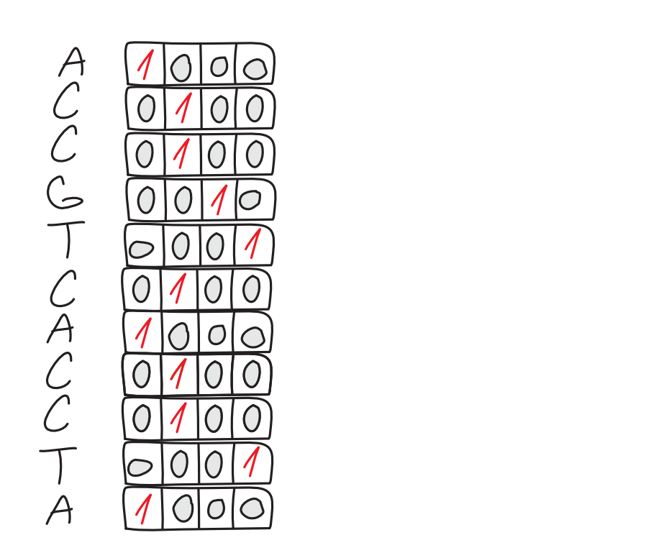

Slide 16
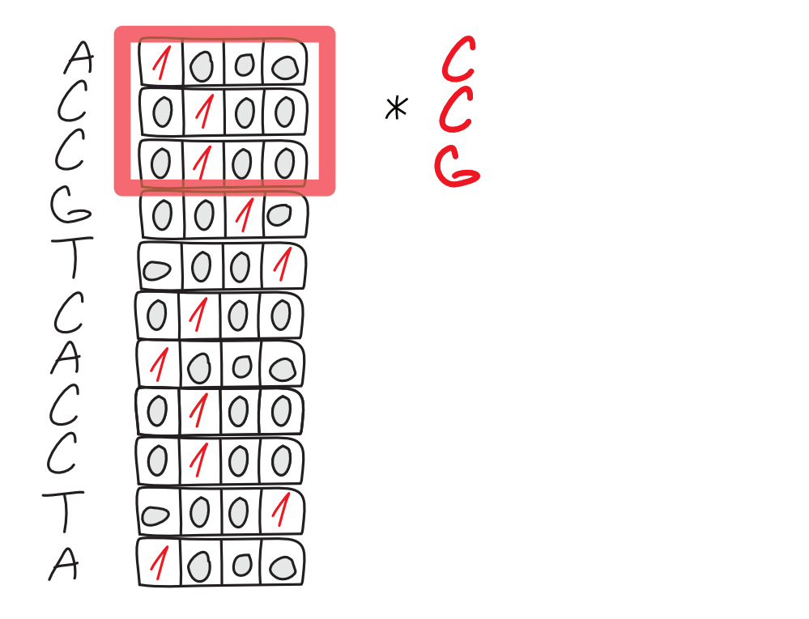

Slide 17
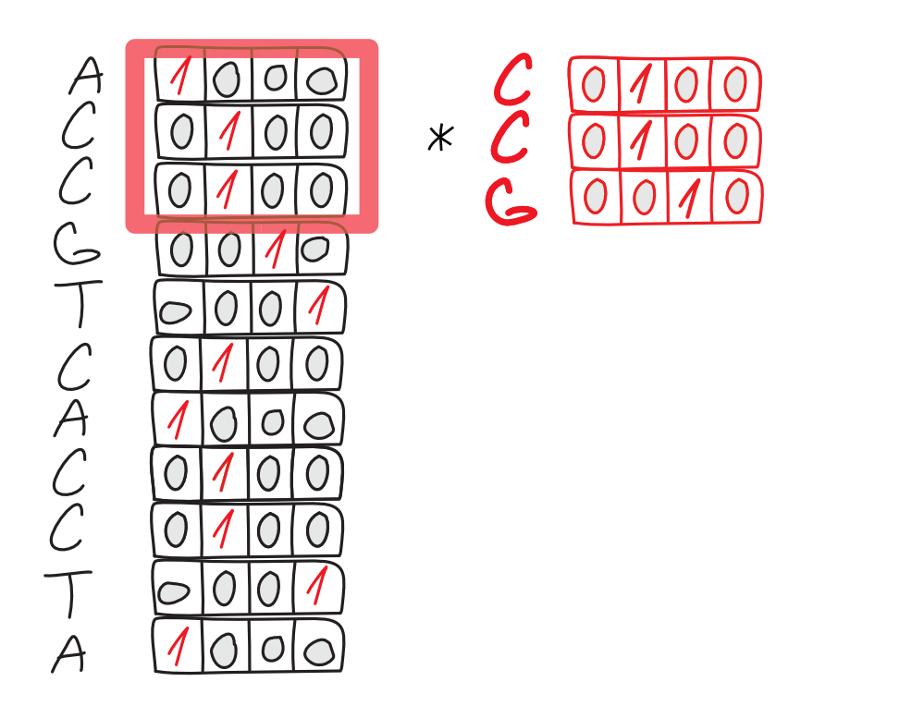

Slide 18
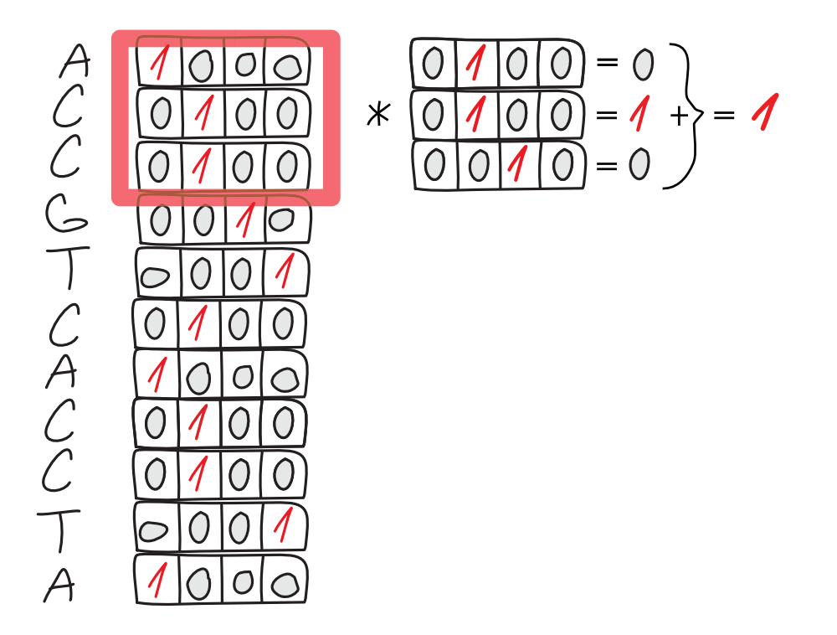

Slide 19
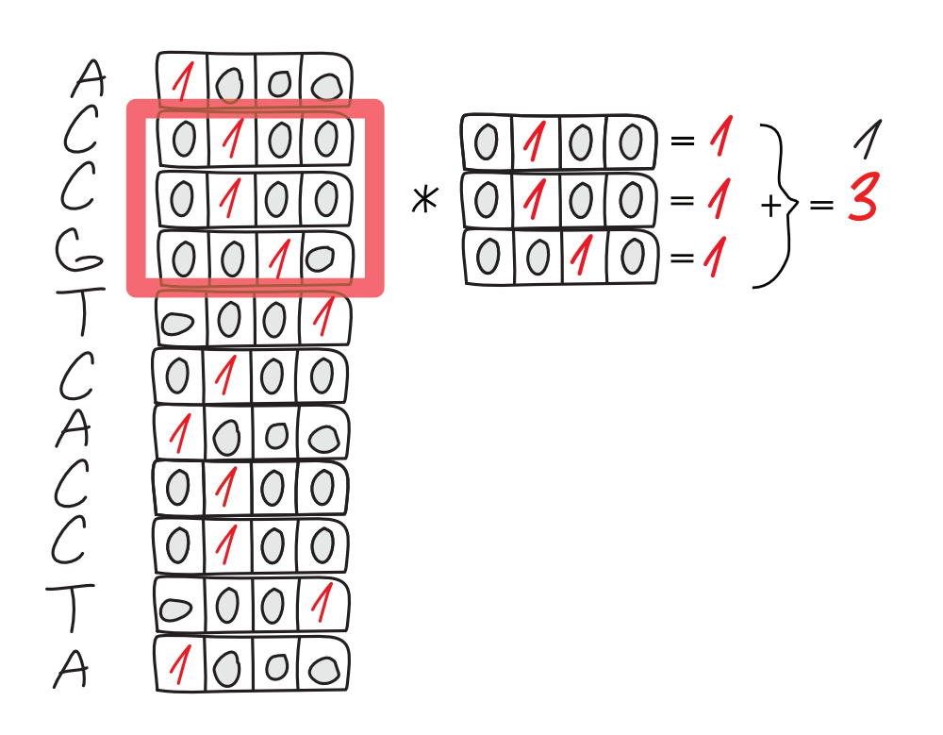

Slide 20
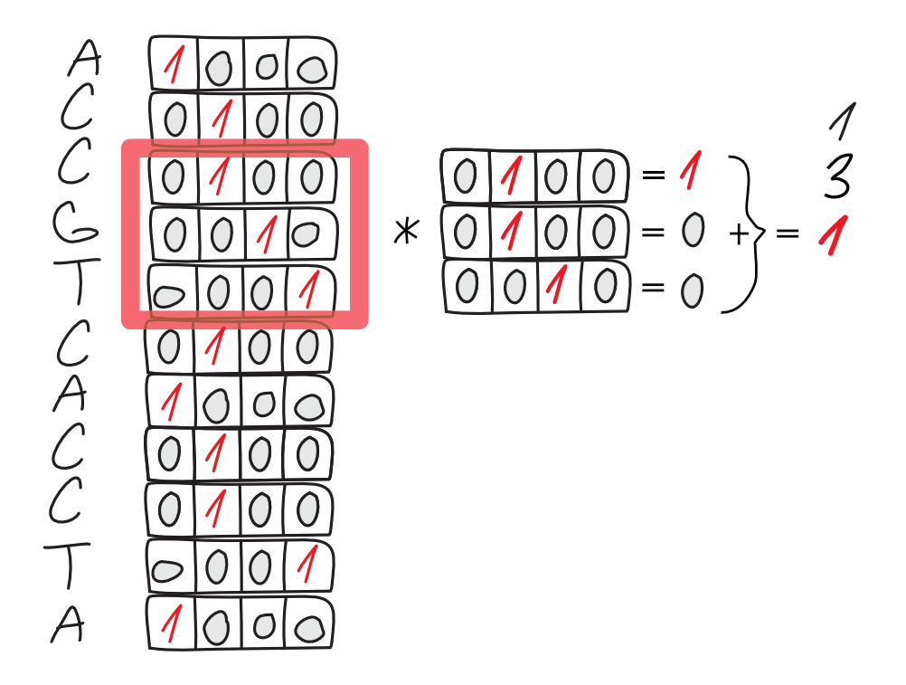

Slide 21
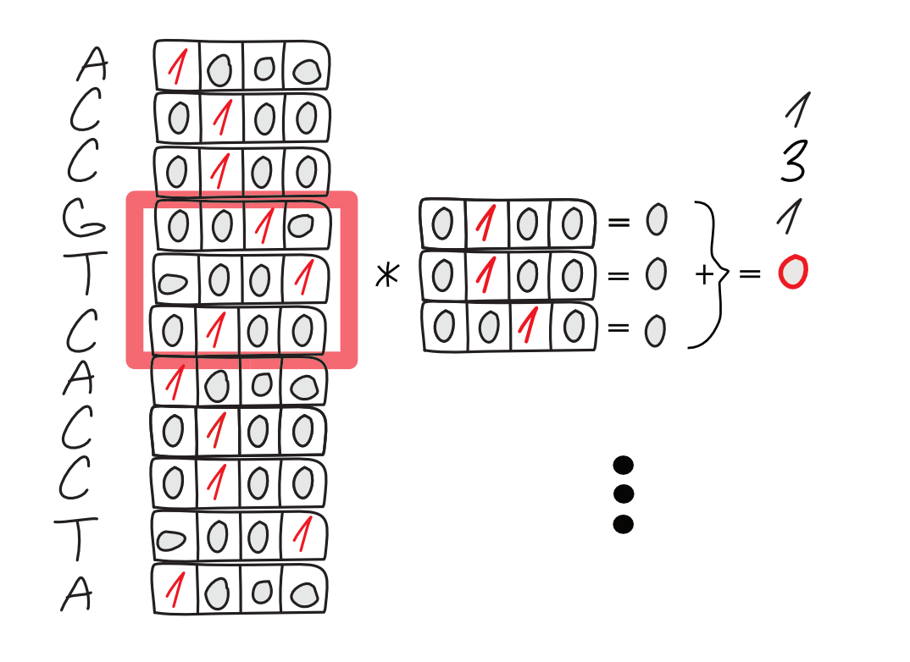

Slide 22
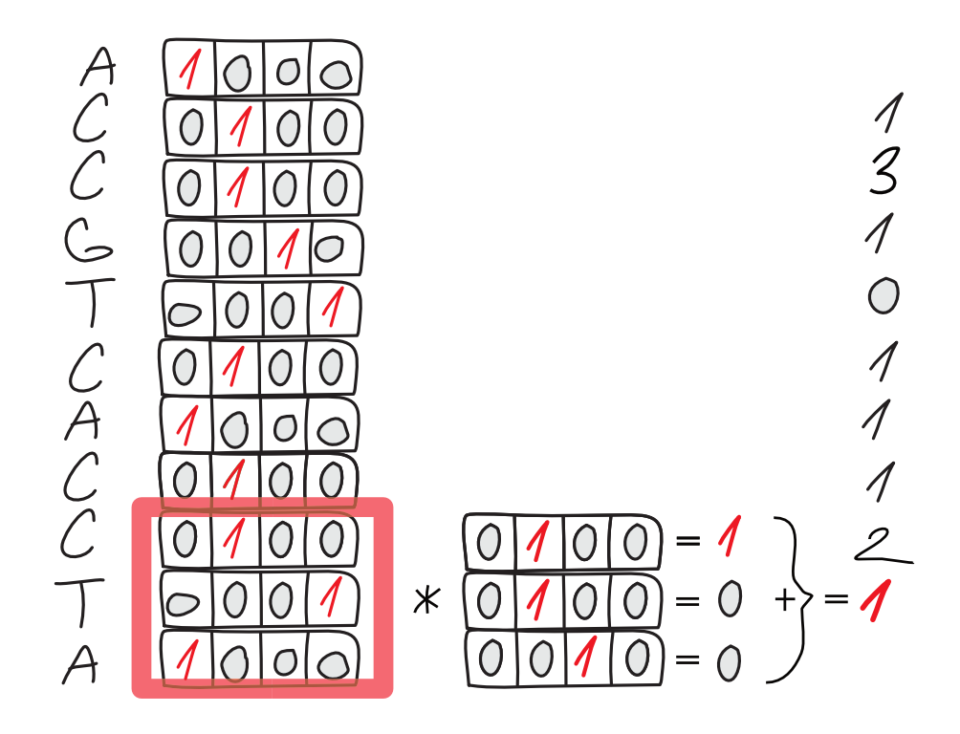

Slide 23
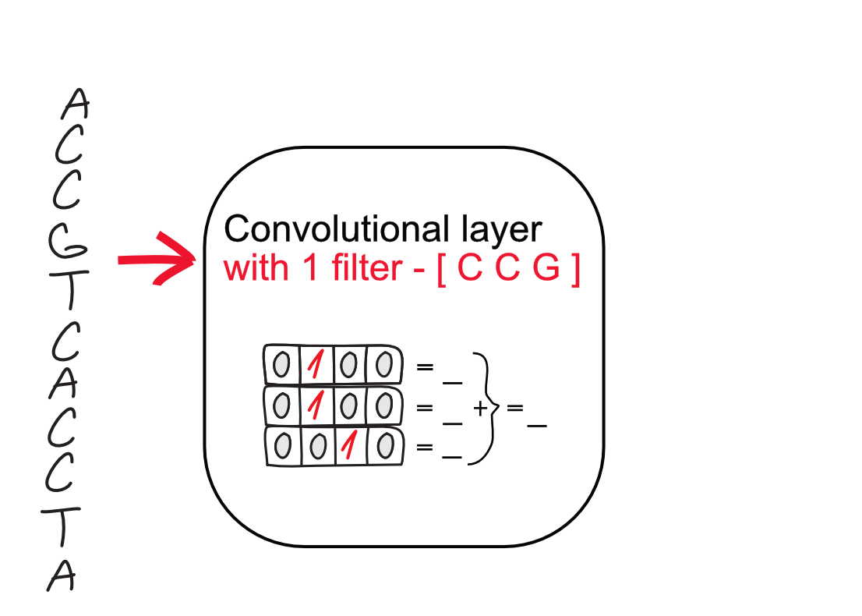

Slide 24
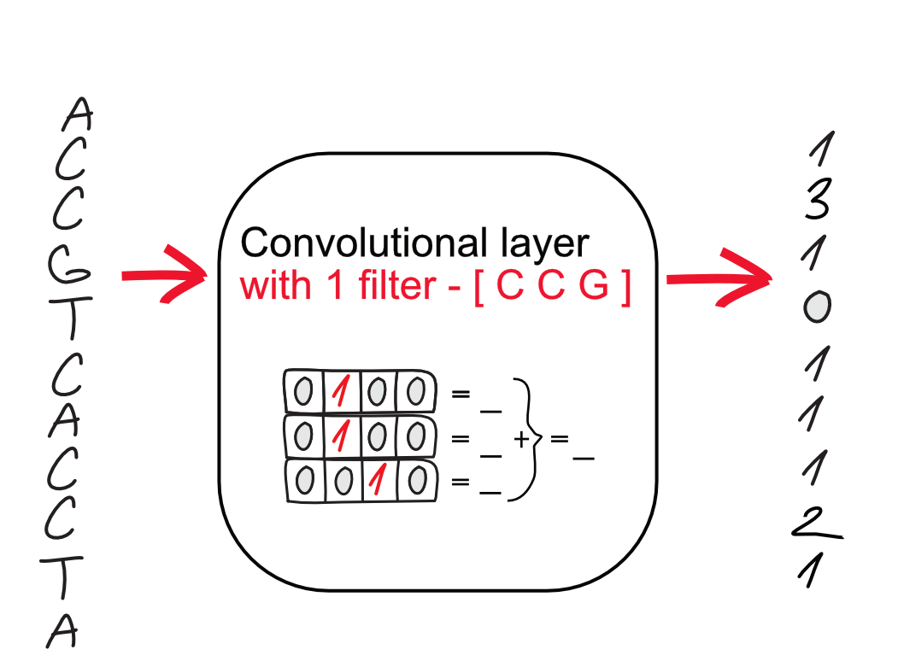

Slide 25
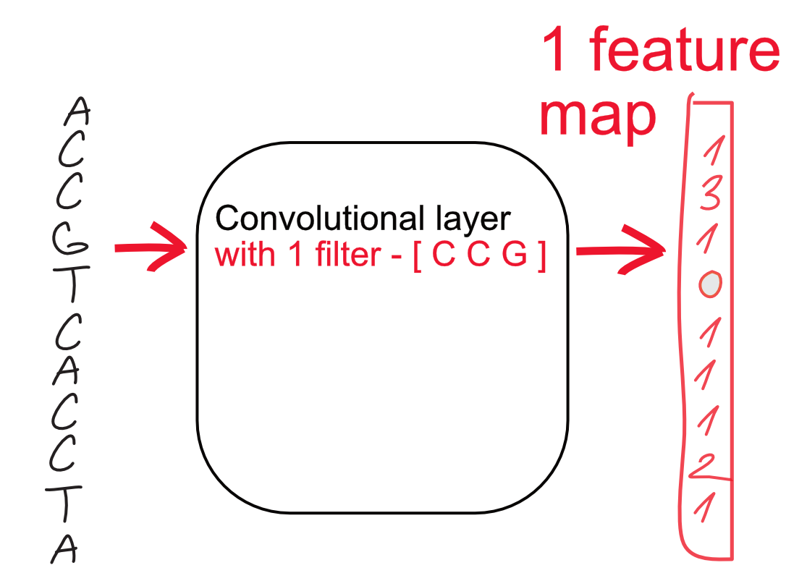

Slide 26
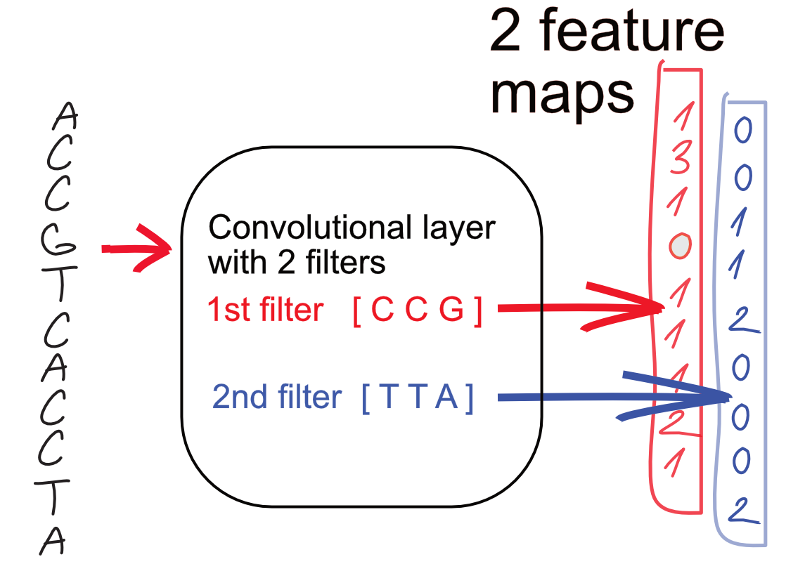

Slide 27
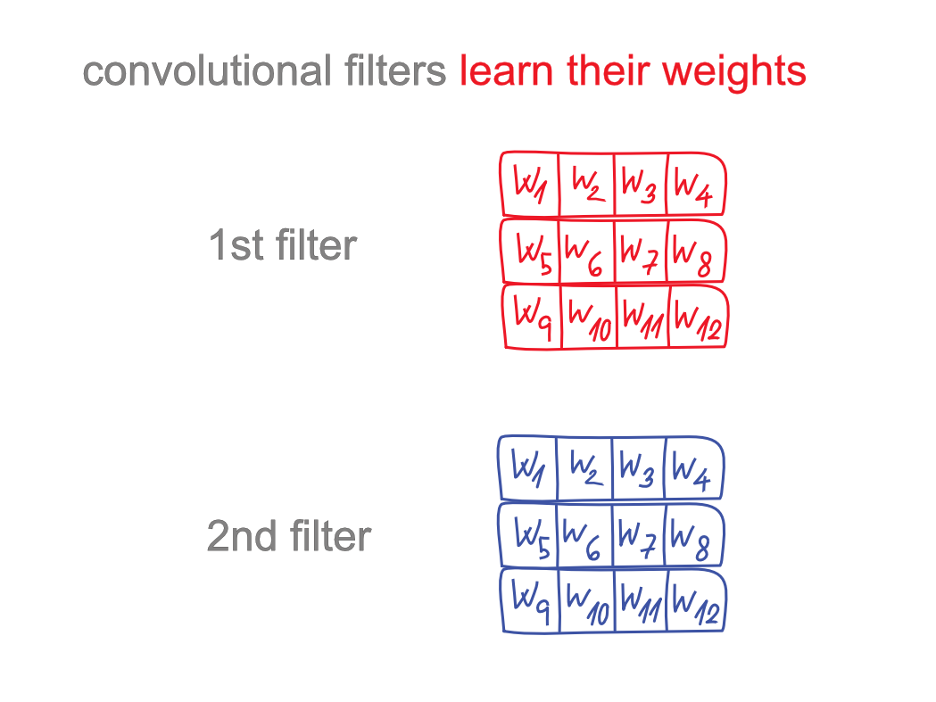

Slide 28
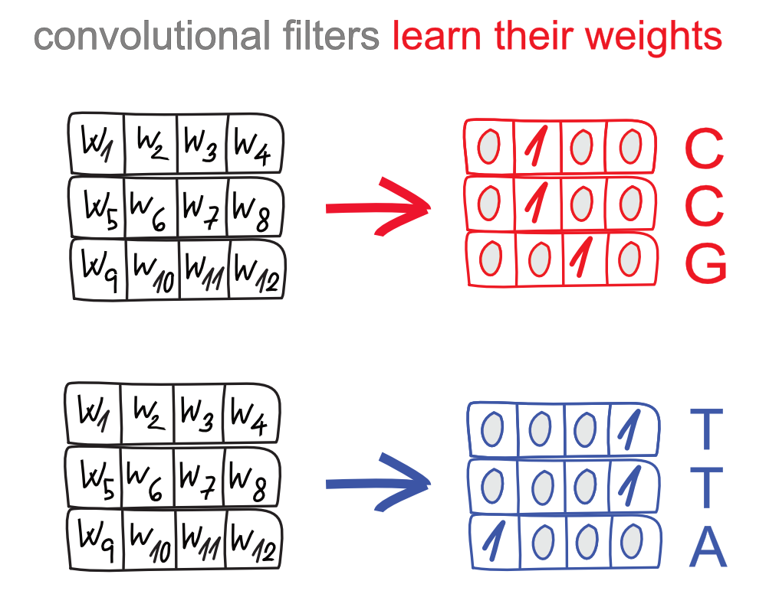

Slide 29
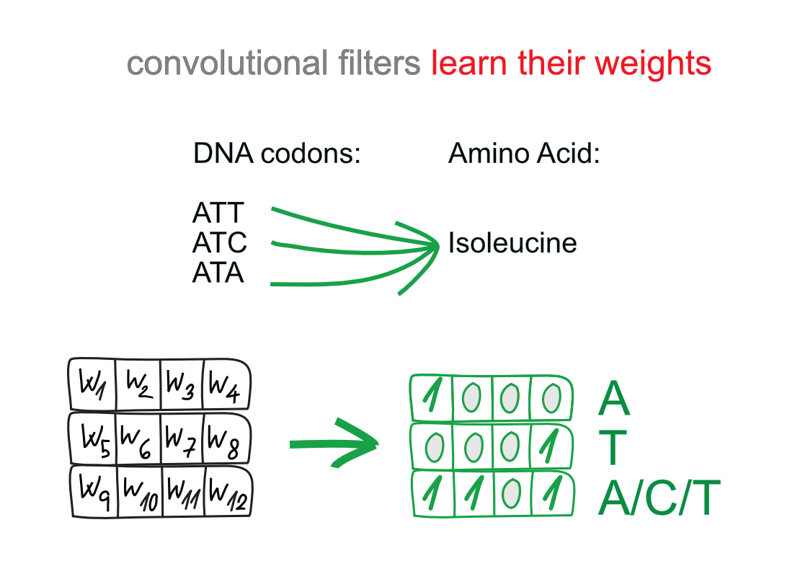

Slide 30
Convolutional layer
Any number of filters
Weights can be any number
0.123
-0.003
Usually very close to 0 for “math reasons”

Slide 31
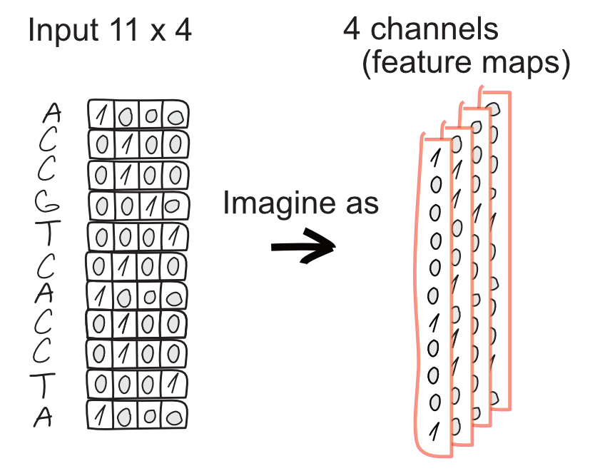
Notes:
Image = matrix of color values
Fixed number of parameters per filter = we need to resize image
Multiple filters -> multiple channels in output. One filter = one feature map of how much is the pattern there
Applying filter -> smaller resolution
Filter goes over all channels, number of filters = num of new channels
PLACEHOLDER - Multiple layers of convolutions
Prekreslit do 1D, zduraznit menici se pocty kanalu a proc

Slide 32
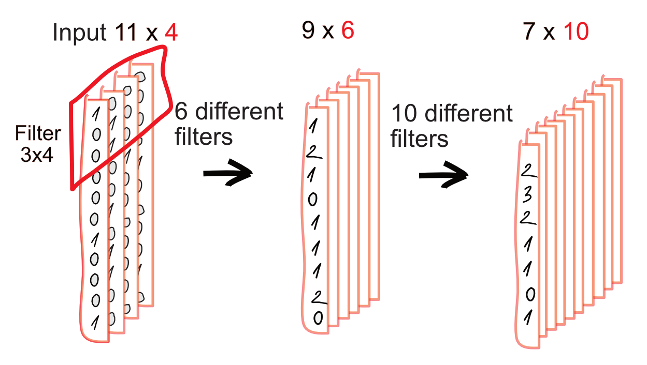
Notes:
Image = matrix of color values
Fixed number of parameters per filter = we need to resize image
Multiple filters -> multiple channels in output. One filter = one feature map of how much is the pattern there
Applying filter -> smaller resolution
Filter goes over all channels, number of filters = num of new channels

Slide 33
(Max) pooling layer
Decrease the spatial dimensions of the input (feature maps)
=> less computational steps
Translation invariance

Slide 34
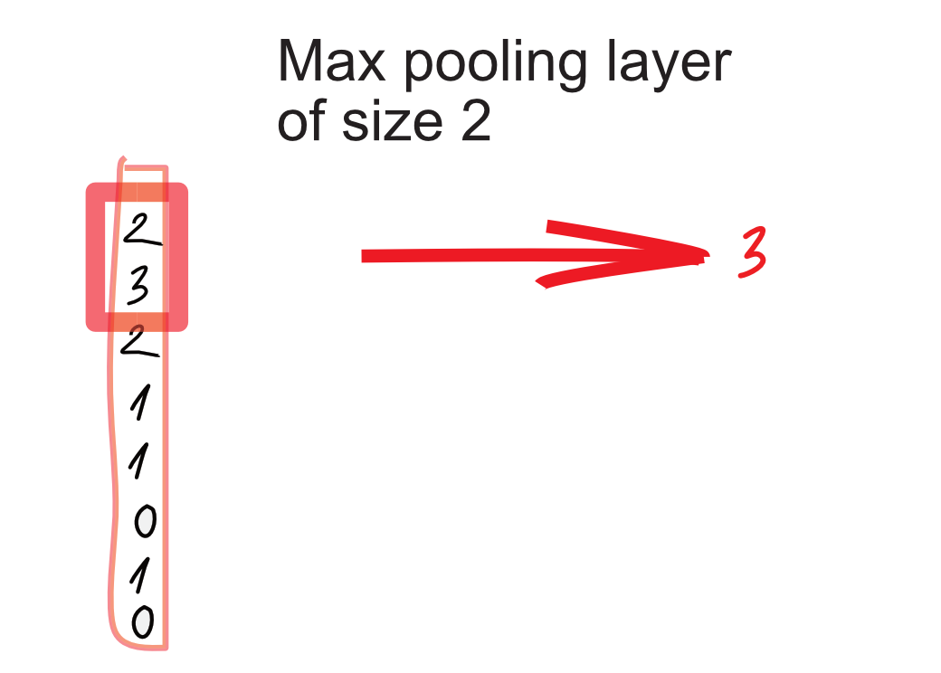

Slide 35
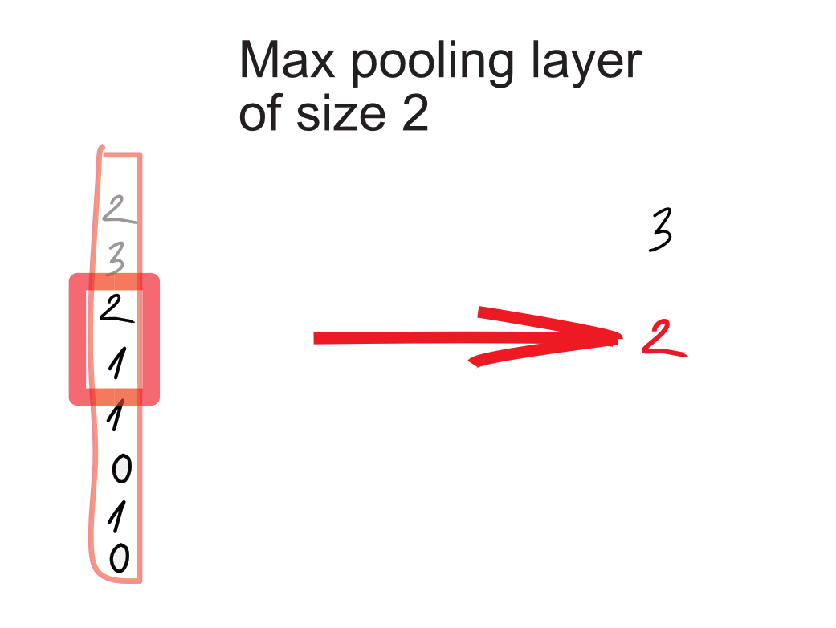

Slide 36
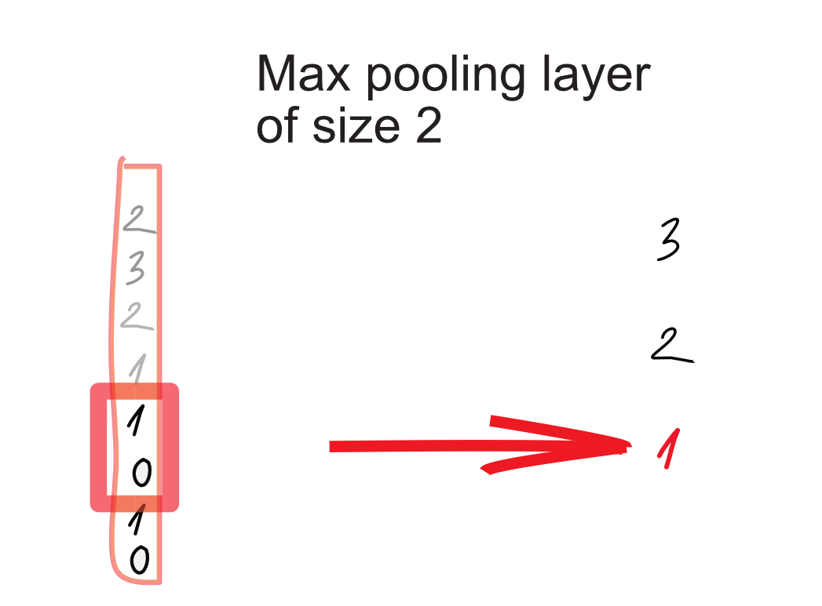

Slide 37
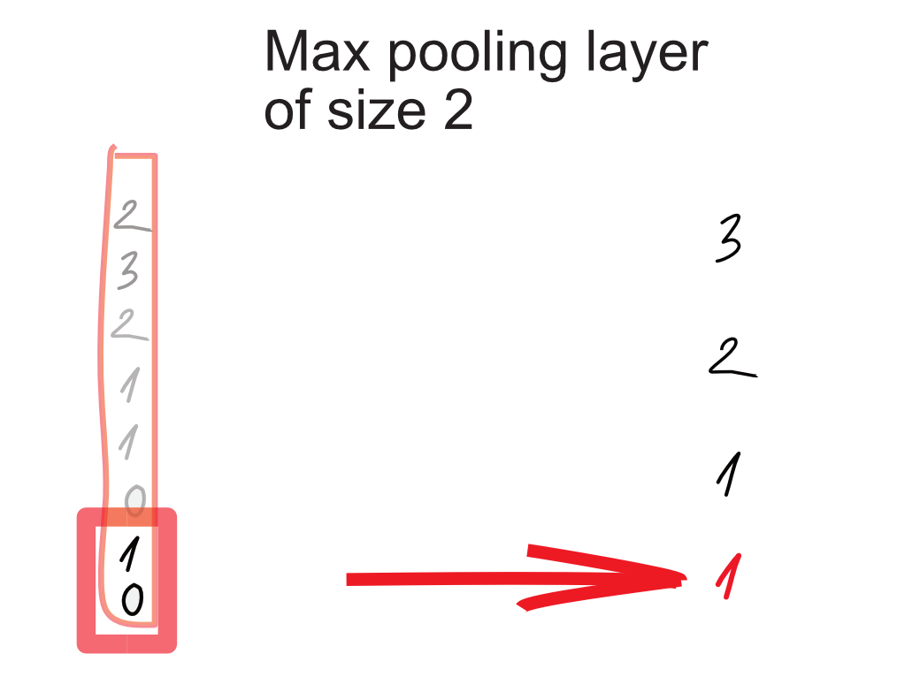

Slide 38
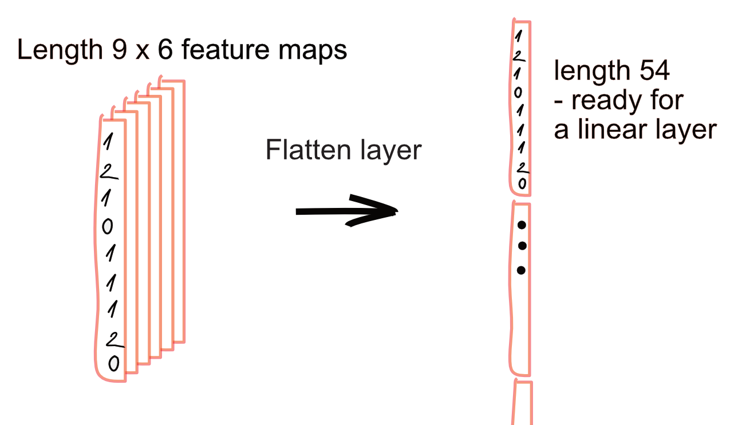
Flatten layer - spread the values
Notes:
The flatten layer is used to convert the feature map that it received from the max-pooling layer into a format that the dense layers can understand. A feature map is essentially a multi-dimensional array that contains pixel values; the dense layers require a one-dimensional array as input for processing.

Slide 39
Convolutional NN - DNA enhancers classification
https://github.com/BioGeMT/MALTAomics-Summer-School/
Day 2 Workshop
MALTA_02_DNA_enhancers.ipynb

Slide 40
Quiz CNNs
How many filters can a convolutional layer have?
Did we just work with a 2-dimensional or 1-dimensional convolution layer?
What is a kernel?
Notes:
Filter (kernel, feature extractor, feature detector)

Slide 41
NOTES
Do pair for coding
Presenting screen super small
Bude se napicu pomahat mezi lidma, radsi udelat pary
Uniprot classification example
Zkušenosti
Většina nemají coding experience
Většina nedělají bioinformatiku daily

Slide 42
NOTES
RE-DRAW CNNs digitally
MERGE with Malta SS github
PRIDAT do notebooku znacky na prechod do slajdu?
TODO sjednotit a zhescit kapitolni slajdy

Slide 43



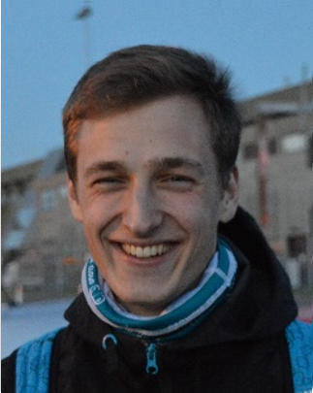


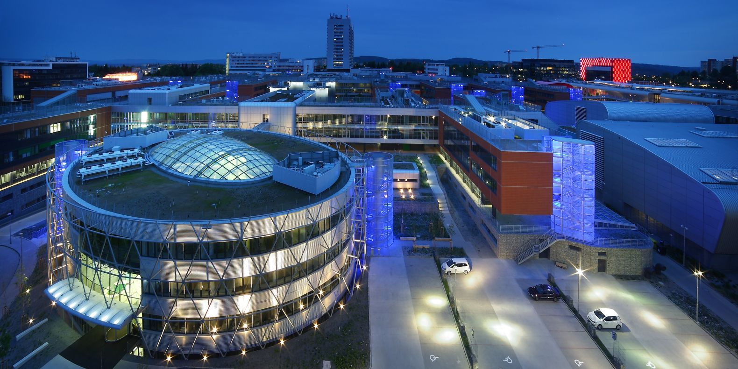

The Team
martinekvlastimil95@gmail.com
Whatsapp +420 732 425 407
davidcechak@gmail.com
Panos
Petr
Vlasta
David
Katarina
Panagiotis Alexiou
Petr
Simecek
Vlastimil
Martinek
David
Cechak
Katarina
Gresova

Slide 44


